Slide 1
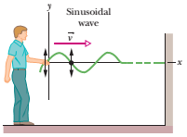
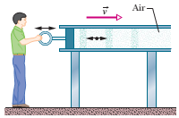
Lecture 17: Waves
Transverse wave:
Vibration of particles of the string perpendicular to the velocity of the propagation of wave
Longitudinal wave:
Vibration of the particle of air parallel to velocity of the propagation of wave

Slide 2
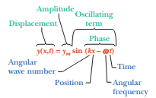
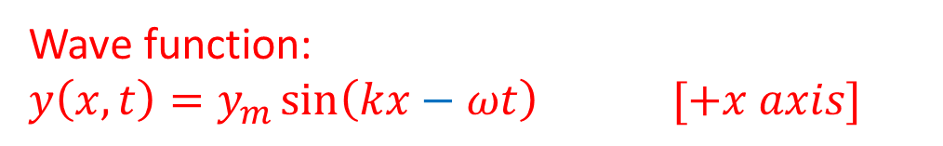
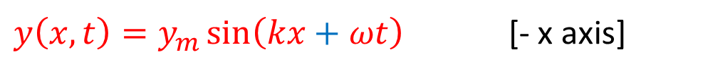
Sinusoidal Function:
Imagine a sinusoidal wave like that of Fig. 16-1b traveling in the positive direction of an x axis. As the wave sweeps through succeeding elements (that is, very short sections) of the string, the elements oscillate parallel to the y axis. At time t, the displacement y of the element located at position x is given by
Wave function:
$$y\left(x,t\right)=y_{m}\sin\left(kx−ωt\right) [+x axis]$$
$y\left(x,t\right)=y_{m}\sin\left(kx+ωt\right)$ [- x axis]
Fig. Transverse sinusoidal wave
Because this equation is written in terms of position x, it can be used to find the displacements of all the elements of the string as a function of time. Thus, it can tell us the shape of the wave at any given time.

Slide 3
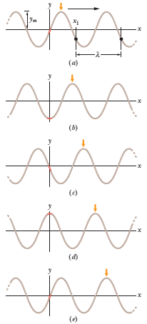
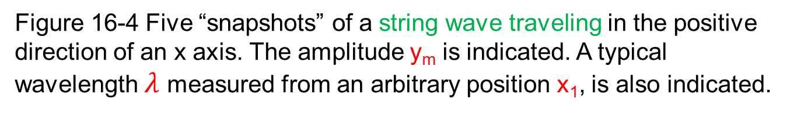
Watch this spot in this series of snapshots.
Figure 16-4 Five “snapshots” of a string wave traveling in the positive direction of an x axis. The amplitude y_{m} is indicated. A typical wavelength $λ$ measured from an arbitrary position x₁, is also indicated.

Slide 4
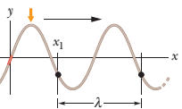
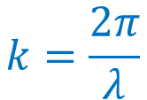

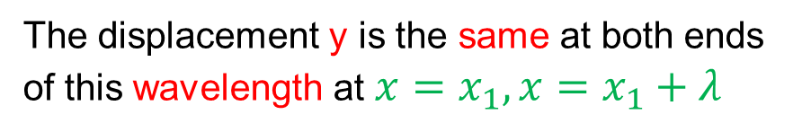

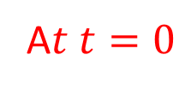

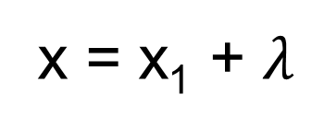

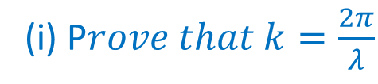


(i) P$rove that k=\frac{2π}{λ}$
$$y\left(x,t\right)=y_{m}\sin\left(kx−ωt\right)$$
The wavelength $λ$ of a wave is the distance (parallel to the direction of the wave’s travel) between repetitions of the shape of the wave (or wave shape).
A$t t=0$
$$y\left(x,0\right)=y_{m}\sin\left\{kx−ω\left(0\right)\right\}=y_{m}\sin{kx}$$
The displacement y is the same at both ends
of this wavelength at $x=x_{1}, x=x_{1}+λ$
x =
x = x₁ + $λ$
$$y\left(x_{1},0\right)=y_{m}\sin{kx_{1}}$$
$$y\left(x_{1}+λ, 0\right)=y_{m}\sin\left\{k\left(x_{1}+λ\right)\right\}$$
$$y\left(x_{1}+λ, 0\right)=y_{m}\sin\left(kx_{1}+kλ\right)$$
$$y\left(x_{1},0\right)=y\left(x_{1}+λ, 0\right)$$
$$y_{m}\sin{kx_{1}}=y_{m}\sin\left(kx_{1}+kλ\right)$$
A sine function begins to repeat itself when its angle (or argument) is increased by $kλ=2π rad$
$$k=\frac{2π}{λ}$$
SI unit of k = rad/m

Slide 5
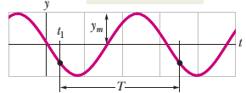








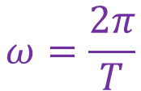


(ii) P$rove that ω=\frac{2π}{T}$
Fig. shows a graph of the displacement y versus time t at a certain position along the string, taken to be x = 0.
$$y\left(x,t\right)=y_{m}\sin\left(kx−ωt\right)$$
$$x=0$$
$$y\left(0,t\right)=y_{m}\sin\left\{k(0)−ωt\right\}$$
$$y\left(0, t\right)={−y}_{m}sin ω{t}$$
We define the period of oscillation T of a wave to be the time any string element takes to move through one full oscillation.
The displacement y is the same at both ends of this time period at t $=t_{1}, t=t_{1}+$T.
$$y\left(0,t_{1}\right)={−y}_{m}sin ω{t_{1}}$$
$$y\left({0, t}_{1}+T\right)={−y}_{m}\sin\left\{ω\left(t_{1}+T\right)\right\}$$
t = t₁+T
t =
$$y\left({0,t}_{1}+T\right)={−y}_{m}\sin\left(ωt_{1}+ωT\right)$$
$$y\left(0,t_{1}\right)=y\left({0,t}_{1}+T\right)$$
$${−y}_{m}\sin{{ωt}_{1}}={−y}_{m}\sin\left(ωt_{1}+ωT\right)$$
This can be true only if$ωT=2π rad$
$$ω=\frac{2π}{T}$$
SI unit of $ω$ = rad/s

Slide 6
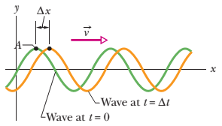




(iii) P$rove that ν=\frac{+ω}{k}$
The wave is traveling in the positive direction of x.
$$y\left(x,t\right)=y_{m}\sin\left(kx−ωt\right)$$
If point A retains its displacement as it moves, the phase giving it that displacement must remain a constant:
$$phase=kx−ωt=constant$$
$$kx −ωt =constant$$
This phase (argument) is constant but both x and t are changing. In fact, as t increases, x must also, to keep the argument constant. This confirms that the wave pattern is moving in the positive direction of x.

Slide 7
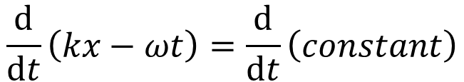
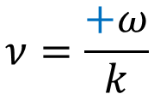


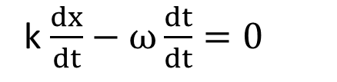
T$o find the wave speed v, we take a derivative of phase=kx−ωt=constant$
$$with respect to t.$$
$$\frac{ⅆ}{ⅆt}\left(kx−ωt\right)=\frac{ⅆ}{ⅆt}\left(constant\right)$$
k $\frac{ⅆx}{ⅆt}−ω\frac{ⅆt}{ⅆt}=0$
$$kv−ω=0$$
$$kv=ω$$
$$ν=\frac{+ω}{k}$$
The plus sign verifies that the wave is indeed moving in the positive direction of x.
$ν=\frac{ω}{k}$ $=\frac{\frac{2π}{T}}{\frac{2π}{λ}}=\frac{2π}{T} (\frac{λ}{2π})=\frac{λ }{T}$= f$λ$
The equation $\frac{λ }{T}$ tells us that the wave speed is one wavelength per period; the wave moves a distance of one wavelength in one period of oscillation.

Slide 8








(iv) P$rove that ν=\frac{− ω}{k}$
The wave is traveling in the negative direction of x.
$$y\left(x,t\right)=y_{m}\sin\left(kx−ωt\right)$$
$$\overline{v}$$
A
y
$$t=−t$$
$$y\left(x,t\right)=y_{m}\sin\left(kx+ωt\right)$$
-x
If point A retains its displacement as it moves, the phase giving it that displacement must remain a constant:
t = Δt
t = 0
$$phase=kx+ωt=constant$$
$$kx +ωt =constant$$
The x decrease with time. Thus, a wave is traveling in the negative direction of x.

Slide 9
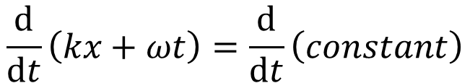
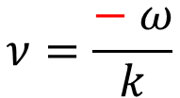


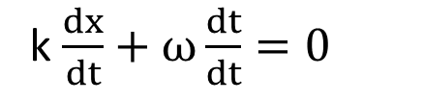
T$o find the wave speed v, we take a derivative of phase=kx+ωt=constant$
$$with respect to t.$$
$$\frac{ⅆ}{ⅆt}\left(kx+ωt\right)=\frac{ⅆ}{ⅆt}\left(constant\right)$$
k $\frac{ⅆx}{ⅆt}+ω\frac{ⅆt}{ⅆt}=0$
$$kv+ω=0$$
$$kv=− ω$$
$$ν=\frac{− ω}{k}$$
The minus sign verifies that the wave is indeed moving in the negative direction of x.

Slide 10
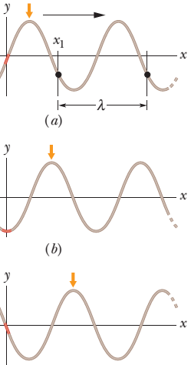
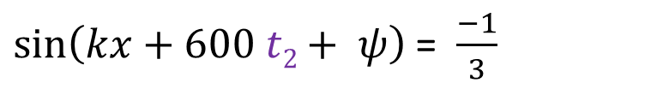
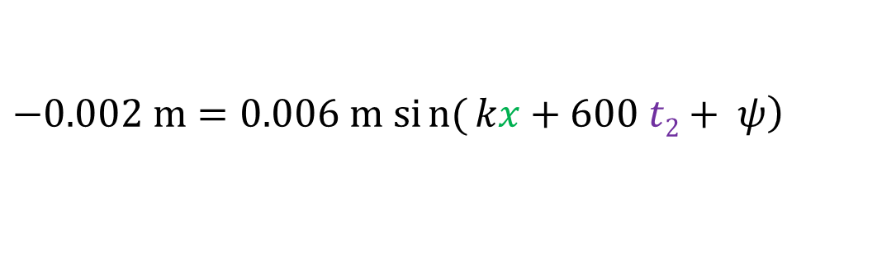
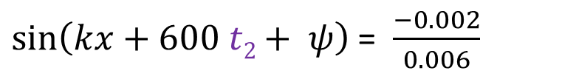
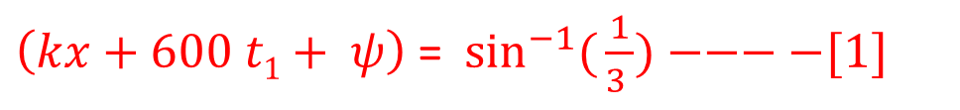
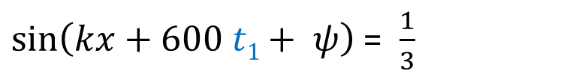

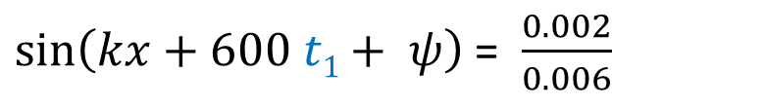
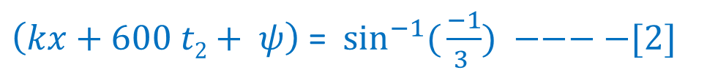
1. If a wave y(x, t) = (6.0 mm) sin(kx + (600 rad/s)t + φ) travels along a string, how much time does any given point on the string take to move between displacements y = + 2.0 mm and y = - 2.0 mm?
$$+0.002 m=0.006 m \sin\left(kx+600 t1+ ψ\right)$$
$\sin\left(kx+600 t1+ ψ\right)$ = $\frac{0.002}{0.006}$
x
t₁
$\sin\left(kx+600 t1+ ψ\right)$ = $\frac{1}{3}$
$\left(kx+600 t1+ ψ\right)$= $\sin^{−1}({\frac{1}{3 })−−−−[1]}$
$$\left.−0.002 m=0.006 m sin{(}kx+600 t2+ ψ\right)$$
$\sin\left(kx+600 t2+ ψ\right)$ = $\frac{−0.002}{0.006}$
$\sin\left(kx+600 t2+ ψ\right)$ = $\frac{−1}{3}$
t₂
x
$\left(kx+600 t2+ ψ\right)$= $\sin^{−1}({\frac{−1}{3 }) −−−−[2]}$
$$\left[1\right]−[2]$$

Slide 11
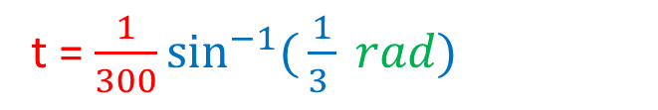
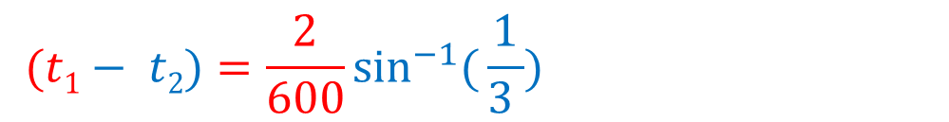

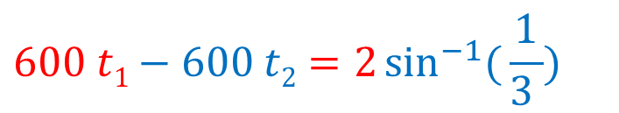
$(kx+600 t1+ ψ) −(kx+600 t2+ ψ)=\sin^{−1}({\frac{1}{3 })} −$ $\sin^{−1}({\frac{−1}{3 })}$
$kx+600 t1+ ψ −kx−600 t2− ψ=\sin^{−1}({\frac{1}{3 })}+$ $\sin^{−1}({\frac{1}{3 })}$
$$600 t1−600 t2=2\sin^{−1}({\frac{1}{3 })}$$
$$600 (t1− t2)=2\sin^{−1}({\frac{1}{3 })}$$
$$(t1− t2)=\frac{2}{600}\sin^{−1}({\frac{1}{3 })}$$
t = $\frac{1}{300}\sin^{−1}({\frac{1}{3 } rad)}$
t = 0.001133 s [Ans]

Slide 12
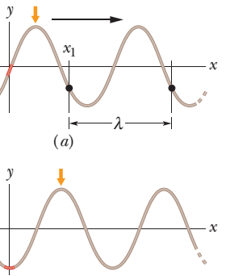


5. A sinusoidal wave travels along a string. The time for a particular point to move from maximum displacement to zero is 0.170 s. What are (a) the period and (b) frequency? (c) The wavelength is 1.40 m; what is the wave speed?
t₁
(a) t₁ – t₂ = T/4 = 0.170 s T = 4 (0.170) s = 0.680 s (b) f =1/T = (1/ 0.680) Hz = 1.47 Hz (c) λ = 1.40 m v = fλ = 1.47 (1.40) m/s = 2.06 m/s
x
$$\frac{T}{4}$$
$$\frac{T}{2}$$
T
x
t₂

Slide 13
Additional problem:
Sample problem 16.02, page:451

